Slide 1
Technique-Aligned Protocol Profile (TAPP) for Better Metadata Reporting and Curation
Ruolin Deng
June 2026
Geoinformatics Research Group
LDEO-Columbia University

Slide 2
Metadata
TLDR: Data about other data.
Wiki: Metadata (or metainformation) is data (or information) that defines and describes the characteristics of other data. It often helps to describe, explain, locate, or otherwise make data easier to retrieve, use, or manage.

Slide 3
Issues in Metadata Reporting and Curation
Decoupled data and metadata between database and publication
Both data and metadata are reported in publications, while databases focus more on capturing complete datasets than complete metadata.
Issue: Difficulty in data quality evaluation and reproducibility by database users
Inconsistent metadata reporting standards
Databases and publishers all have different metadata reporting requirements;
General standards are often too broad, while specified standards are too few.
Issue: Insufficient metadata reporting.
Not in machine-readable or AI-ready formats
Metadata is usually reported in tables, footnotes, or natural language descriptions in the main text.
Issue: Difficulty in setting up search algorithm for metadata or applying machine-learning/AI tools.

Slide 4
Types of Metadata in Geoscience
Dataset Metadata:
Title, dataset creator, publication date, data type…
Usually required in a database.
Sample Metadata:
Sample name, material, unique persistent identifier (e.g., IGSN)…
Usually required in a database.
Analytical Metadata:
Technique, Method: usually required in a database
Protocol, Procedure: not commonly required in a database, nor is it easy to standardize reporting requirements. This is where TAPP is designed to help improve.

Slide 5
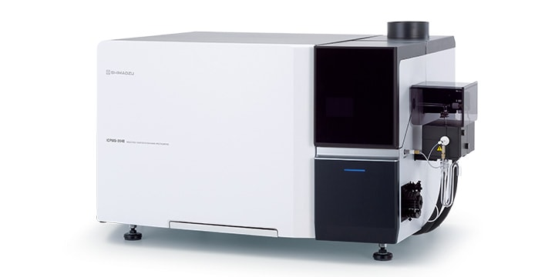

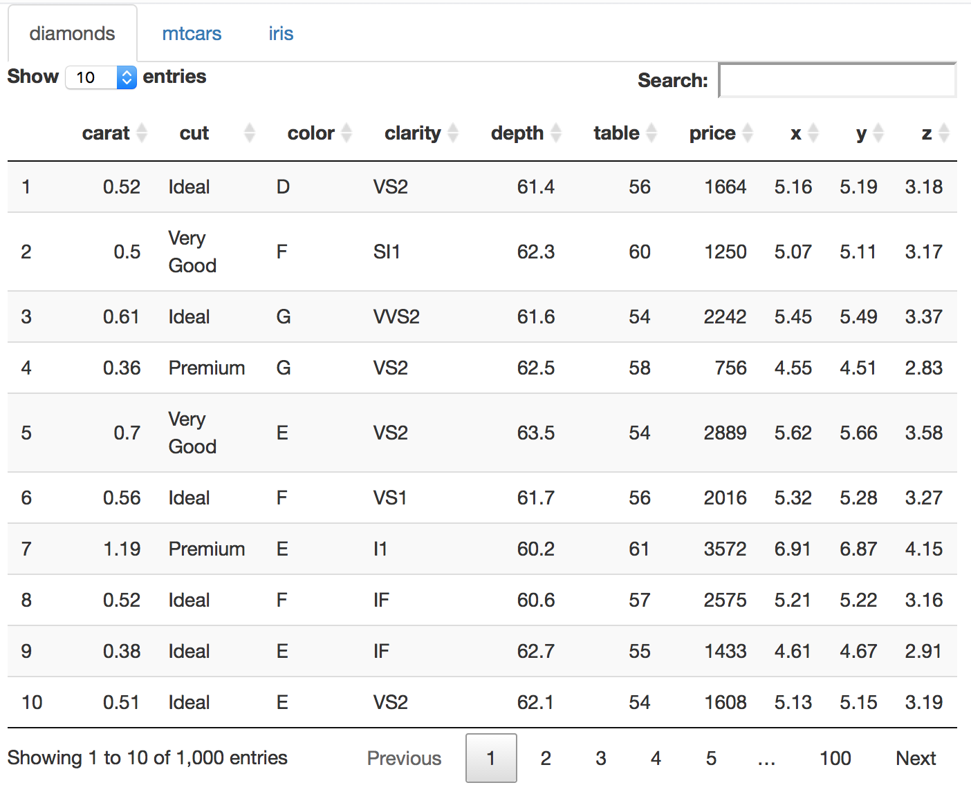
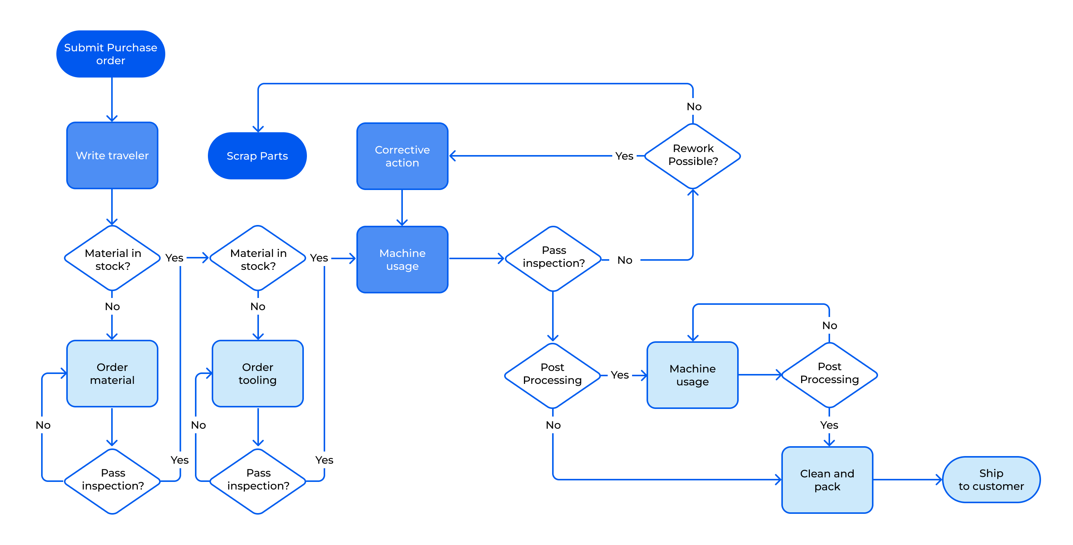

Nomenclature
Technique: a set of chemical or physical principles utilised on an apparatus, instrument, or collection of instruments which can be applied to a sample, material or other medium to yield qualitative or quantitative data.
Method: an application of a technique to a sample, material, or other medium to acquire a specific data type or types, which may provide results and interpretable outcomes.
Protocol: a set of stringent guidelines that specify a procedure that an analyst must follow. “What must be done”. specifies method properties and procedures at the instance level.
Procedure: a documentation of the actual implementation of a protocol. “What was done”. We will avoid using this term for now to minimize confusion with “protocol”.

Slide 6
TAPP
Recommended best practices for reporting protocols.

Slide 7
TAPP
Electron Probe Micro-Analysis (EPMA)
“Olivine major element composition analysis by EPMA”
Protocol A (LDEO)
Protocol B (NASA JSC)
“Carbonate trace element composition analysis by EPMA”
Protocol A (NASA JSC)
Technique
The chemical or physical principle
Method
The application of a technique
Protocol
The recipe of a method
Procedure
The implementation of a protocol
Protocol B (Caltech)
Analysis Session 05/01/2026
Analysis Session 05/20/2026
Analysis Session 03/01/2026
Analysis Session 04/15/2026
Analysis Session 03/25/2026
Analysis Session 04/15/2026
Data
The product of a procedure
Dataset A
Dataset B
Dataset C
Dataset D
Dataset E
Dataset F
Metadata
The data about data

Slide 8
TAPP
Electron Probe Micro-Analysis (EPMA)
“Olivine major element composition analysis by EPMA”
Protocol A (LDEO)
Protocol B (NASA JSC)
“Carbonate trace element composition analysis by EPMA”
Protocol A (NASA JSC)
Technique
The chemical or physical principle
Method
The application of a technique
Protocol
The recipe of a method
Procedure
The implementation of a protocol
Protocol B (Caltech)
Analysis Session 05/01/2026
Analysis Session 05/20/2026
Analysis Session 03/01/2026
Analysis Session 04/15/2026
Analysis Session 03/25/2026
Analysis Session 04/15/2026
Data
The product of a procedure
Dataset A
Dataset B
Dataset C
Dataset D
Dataset E
Dataset F
Metadata
The data about data

Slide 9
TAPP Structure
Protocol Identification
Protocol Name, Protocol Author, Lab, Protocol DOI, Coupled Protocol…
Samples
Target Material, Sample Preparation…
Instrument & Software
Instrument Type, Instrument Configuration, Data Acquisition Software…
Measurement Info
Data Processing
QC & Uncertainty
Analytical Mode, Tuning Method, Instrument Settings, Analyte…
Data Reduction Method, Blank Correction Method…
Precision, Accuracy, Detection Limit, Reference Material…

Slide 10
Human Experts
Agentic AI
Output
Review papers
Scope & Analytical Mode Identification
TAPP Template
Seed Methodology
Papers
TAPP Generation Agent
Preliminary TAPP
Protocol Applications
Reflection Agent
Expert Evaluation
JSON Generation Agent
Finalized TAPP
TAPP JSON Schema

Slide 11
Supplementary Slides

Slide 12


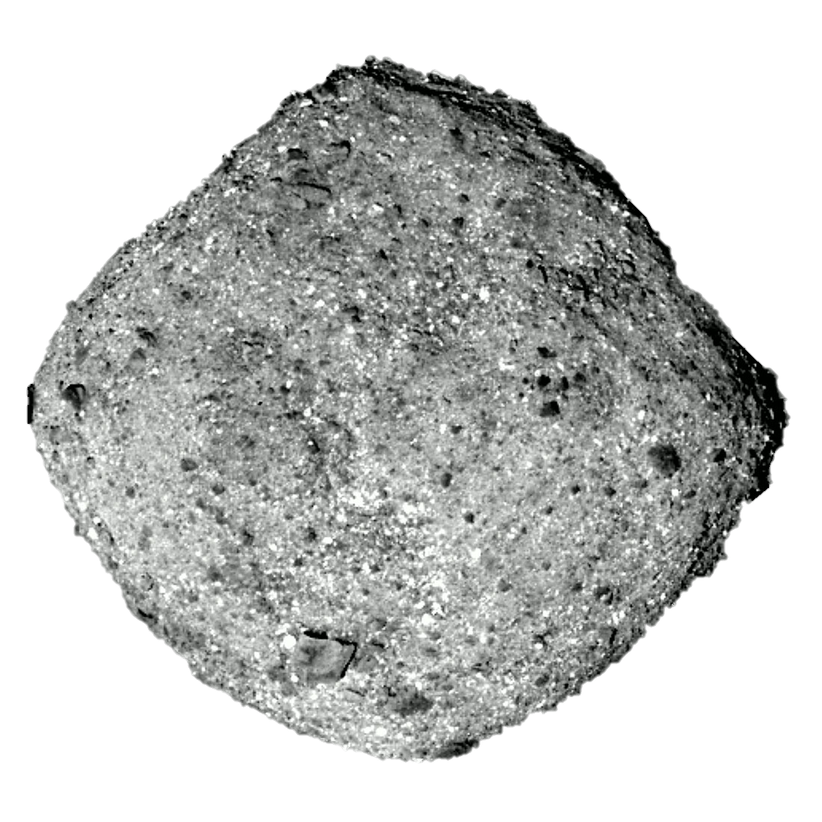
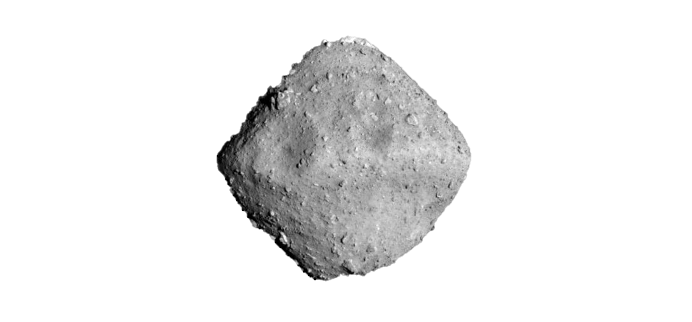
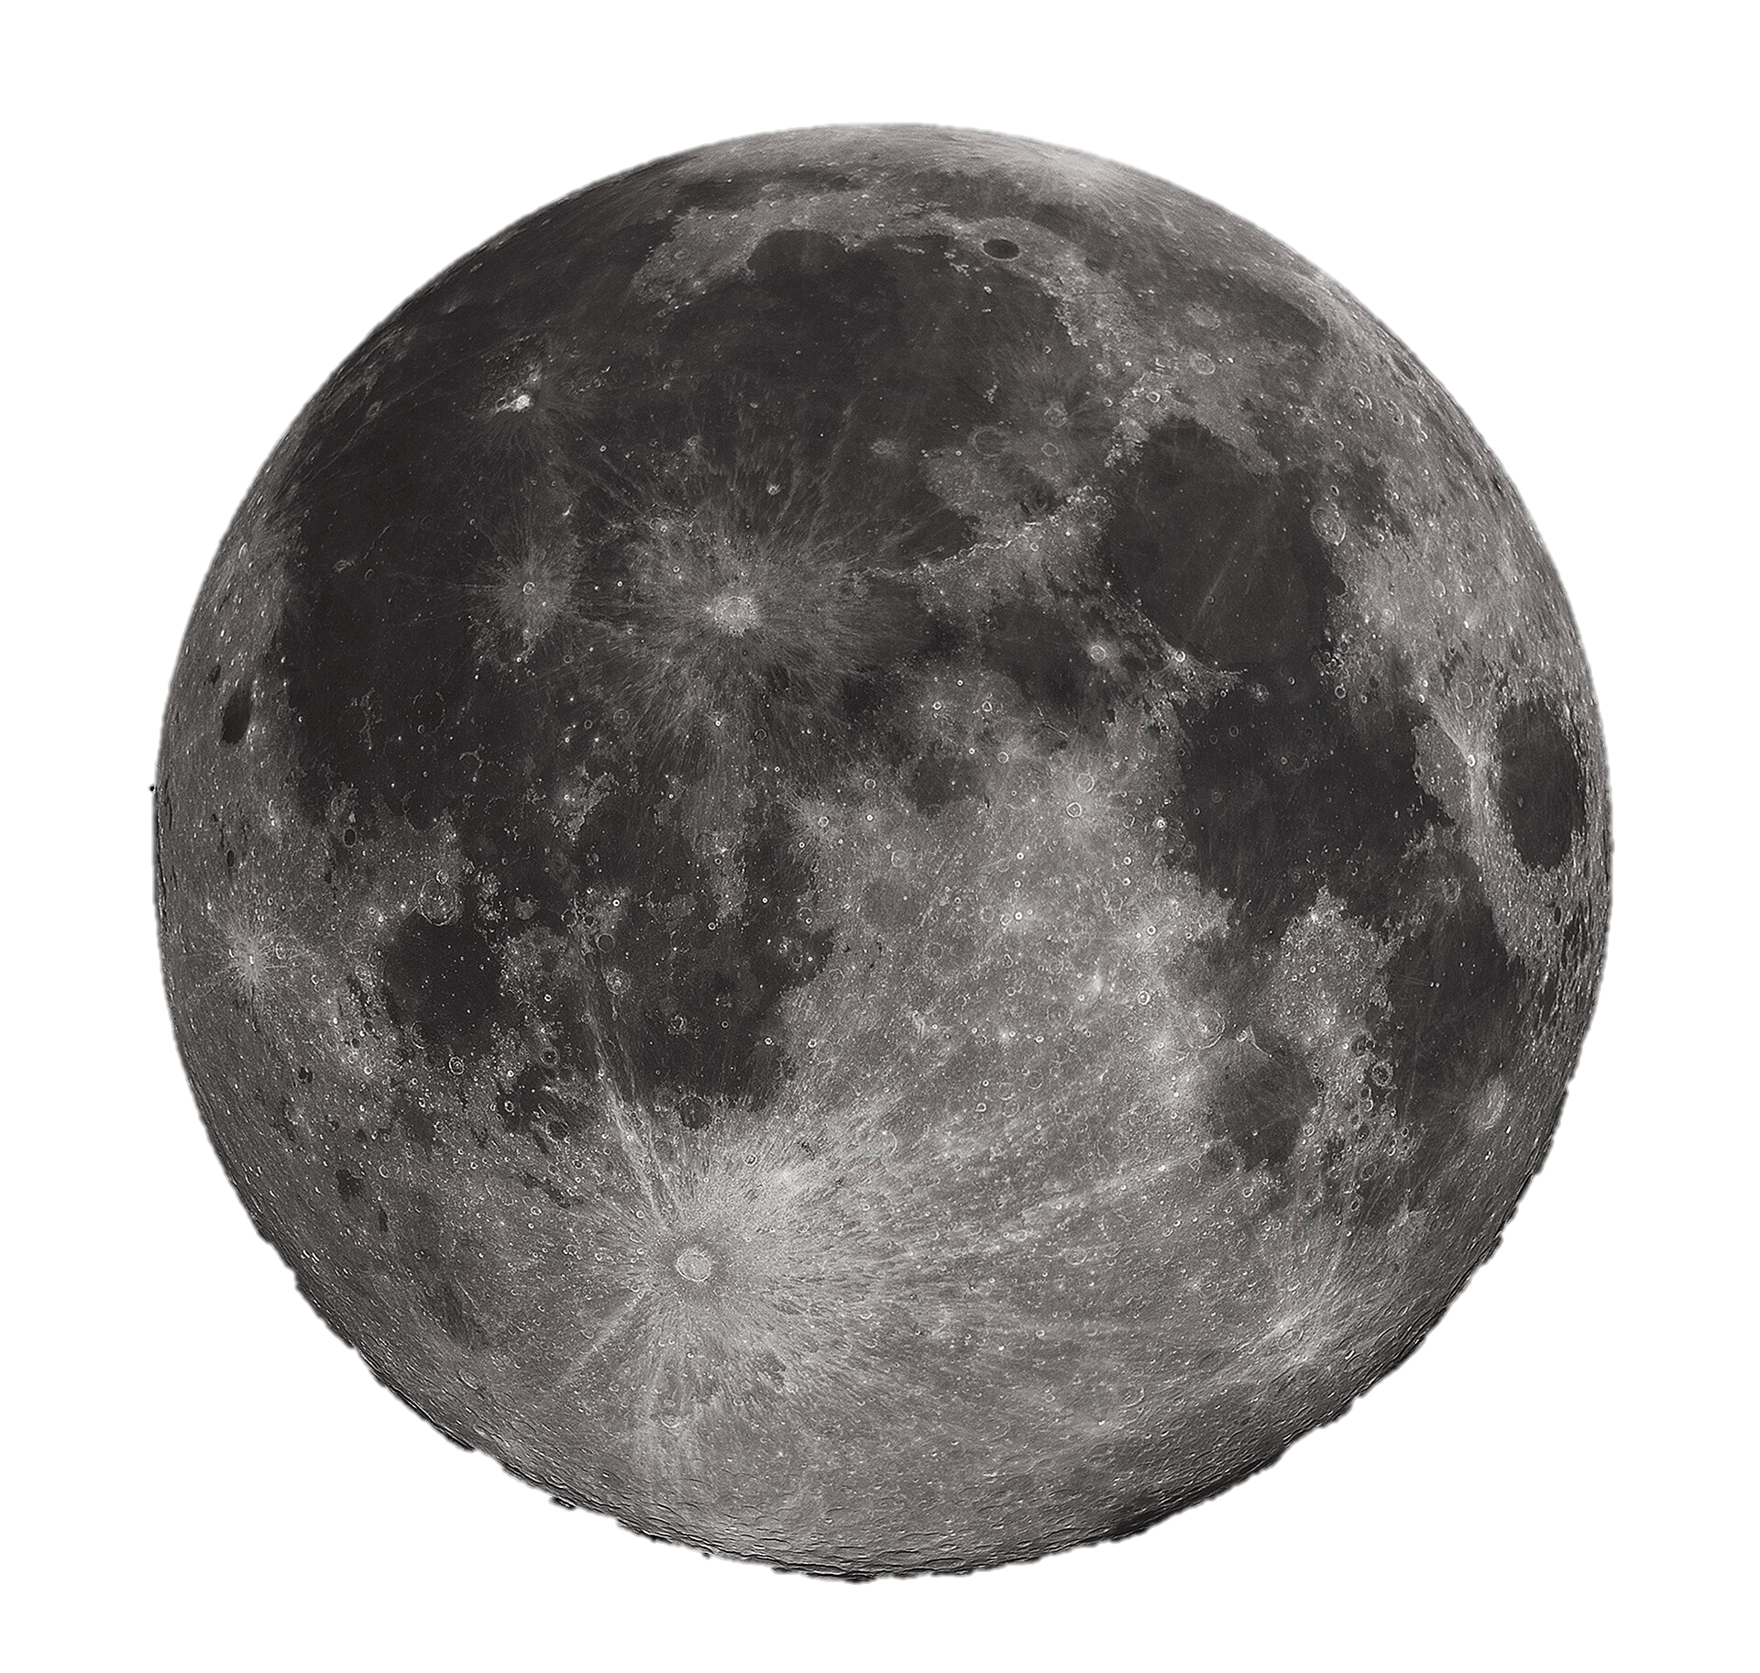
Astromat (astromat.org) is the primary NASA-sponsored archive for laboratory analyses of returned samples from planetary missions as well as meteorites.
Astromaterials Data Archive (ADA)
Astromaterials Data Repository
Astromaterials Data Synthesis
Designated data archive for analytical data generated by the OSIRIS-Rex Sample Analysis Team.
Database for analytical data on astromaterials integrated from existing publications.
> 4,000 Submissions
> 200 Contributors
Data repository for user-submitted digital content on astromaterial analysis.
> 2.5 Million Values
> 5,200 Citations
> 200 Submissions
> 80 Contributors

Slide 13
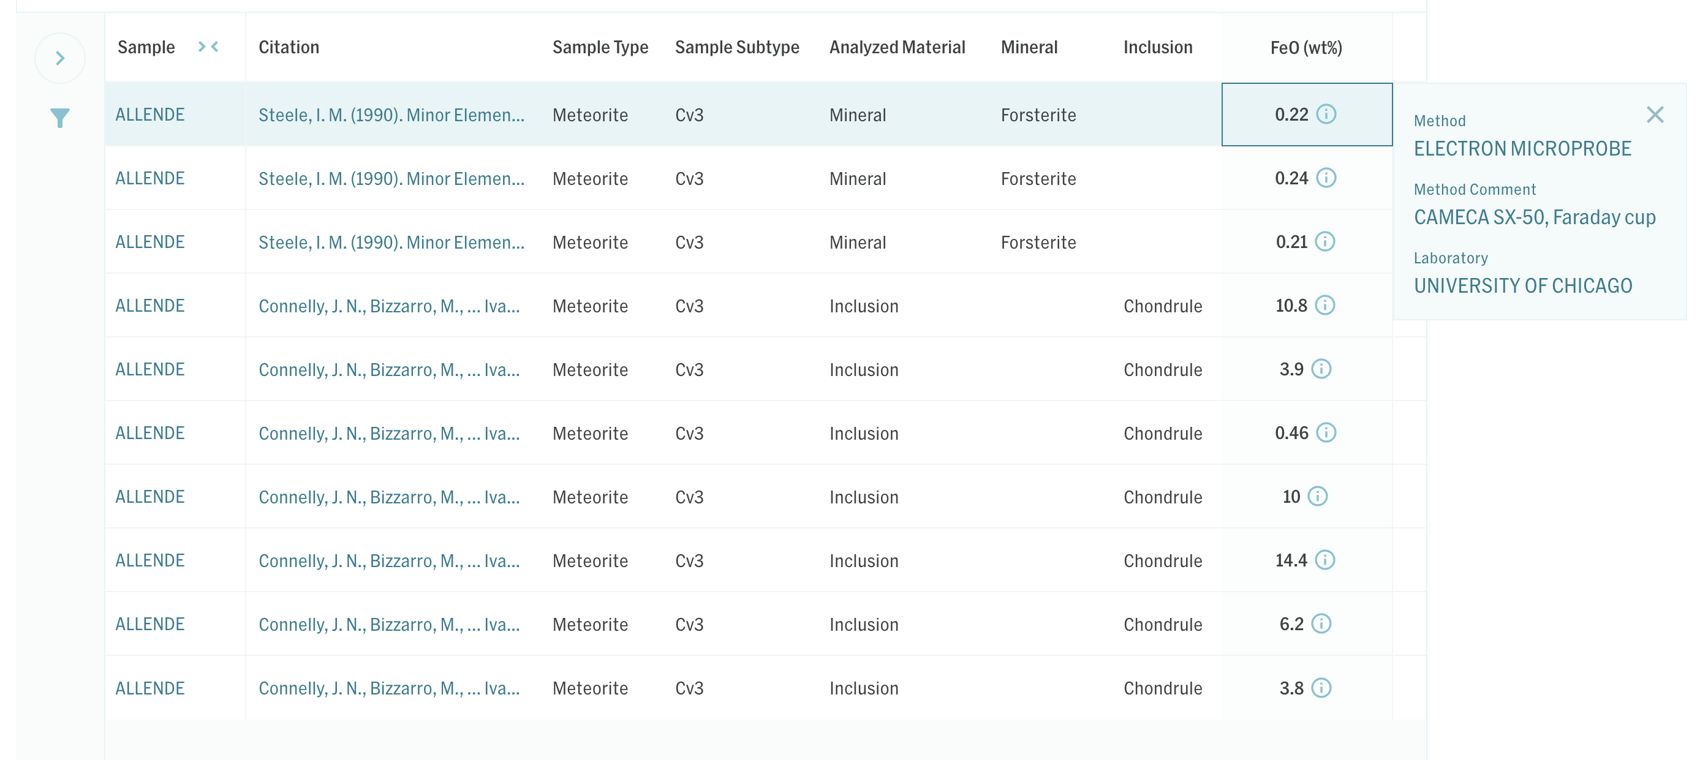
Data in Astromat Synthesis
Dataset Metadata
Sample Metadata
Data
Analytical Metadata

Slide 14
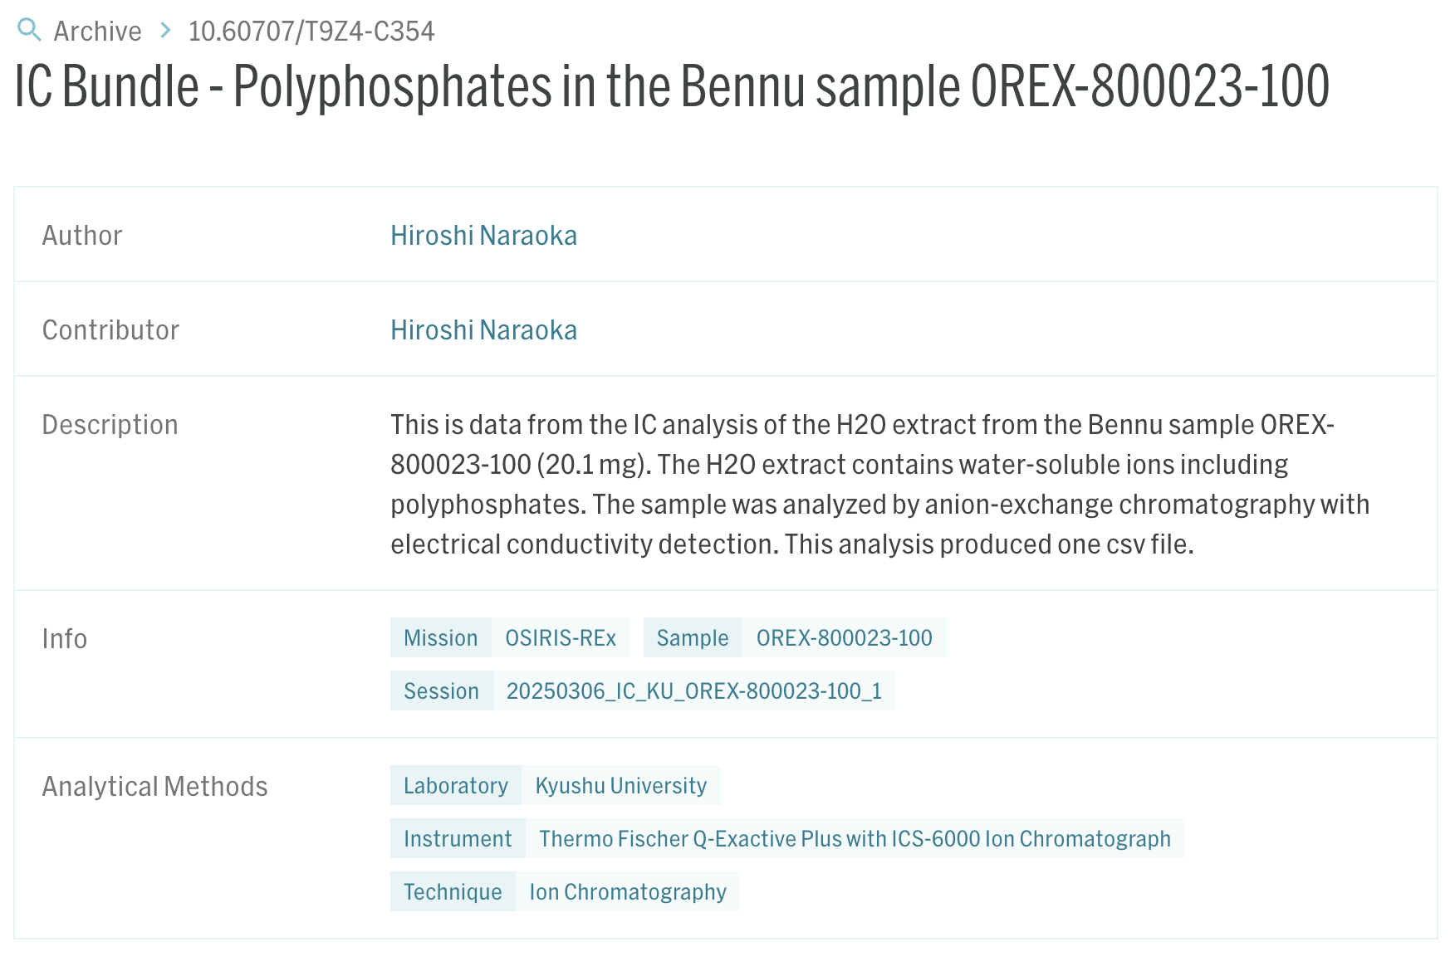
Data in ADA

Slide 15
Data in AstroRepo

Slide 16
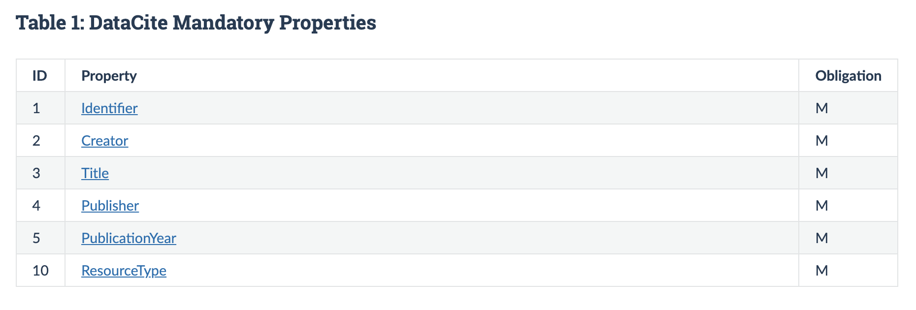
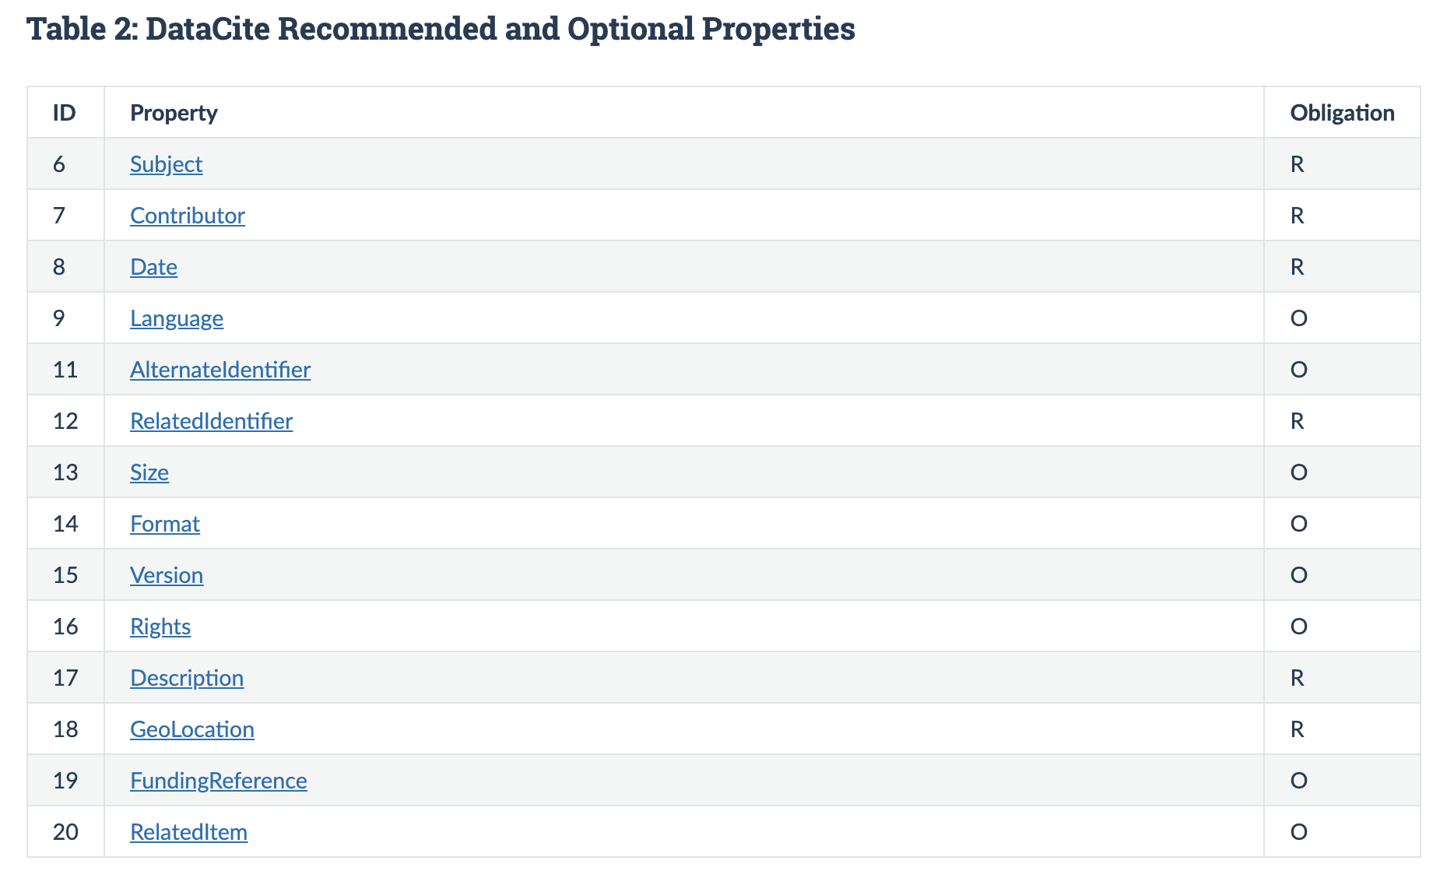
Astromat Metadata Requirement

